Slide 1

Global Bigdata Analytics
At
GroupM
© Nihilent Technologies 2013

Slide 2
Agenda
Business Challenges
Approach
  Analysis
  Data Integration Architecture
  Reporting
Conclusion
© Nihilent Technologies 2013

Slide 3
Business Challenges
Cookie Level Data collection and Aggregation
Variety of data sources - 50 sources and 80 countries
Data Analysis and Transformation
Single source of storage
Data analytics & Reporting
© Nihilent Technologies 2013

Slide 4
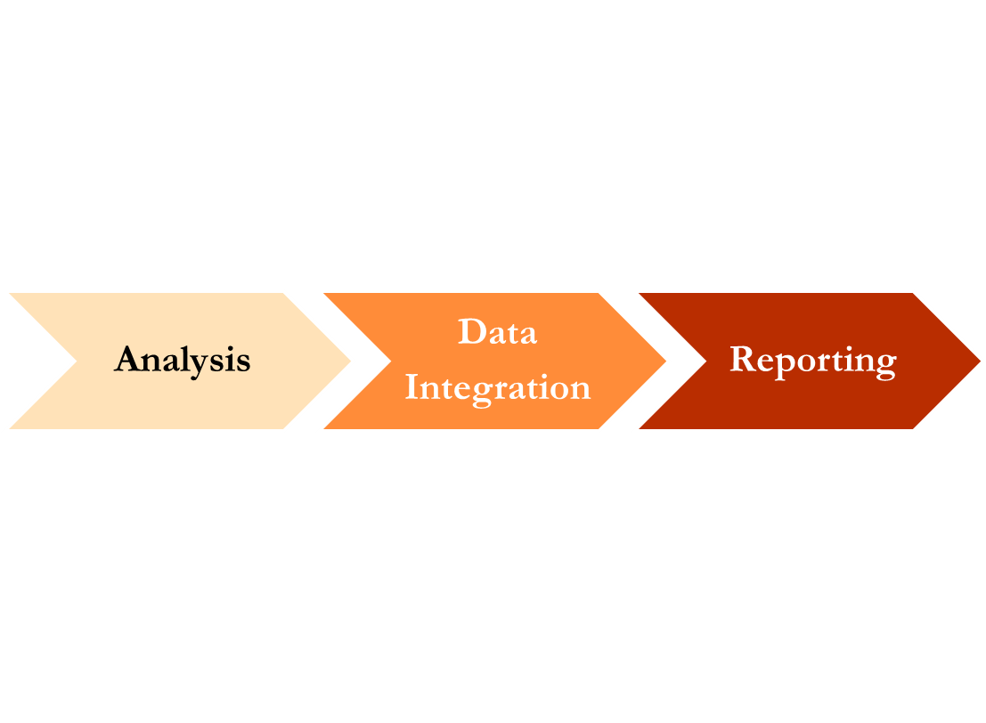
Approach
The approach will be identifying and analyzing different data sources, defining a Data Integration architecture and then generation of business analytical reports.
© Nihilent Technologies 2013

Slide 5
Analysis
Identify various sources of data
  Web Clickstreams
  Ad Viewing
  Social Networking data
  Site/Customer Behavior
  Application Logs
  Weblogs
Classification of data
Executing Data Mapping on analyzed data sources
© Nihilent Technologies 2013

Slide 6
Data Integration(ETL)
Data Extraction from various sources using Hadoop – Flume/Sqoop
Transformation is performed through massive parallel processing(MPP) systems like Hadoop Ecosystem
Load Transformed data into Data-stores (RDBMS, NoSQL, MPP Database)
© Nihilent Technologies 2013

Slide 7
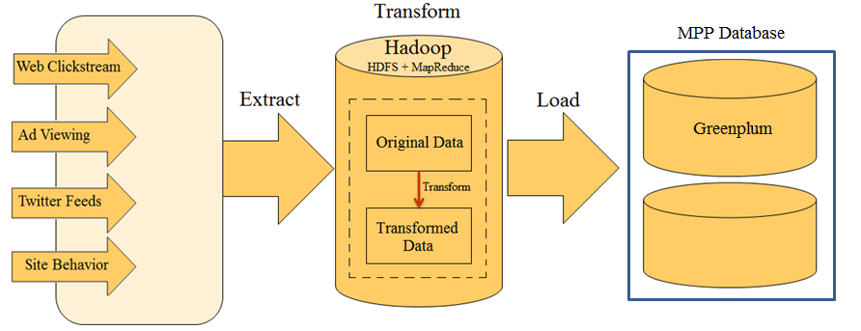
Data Integration : Architecture
© Nihilent Technologies 2013

Slide 8
Reporting
Reporting tool will be integrated with Bigdata Hadoop
Wide variety of reporting and analysis can be performed on Data Stores
© Nihilent Technologies 2013

Slide 9
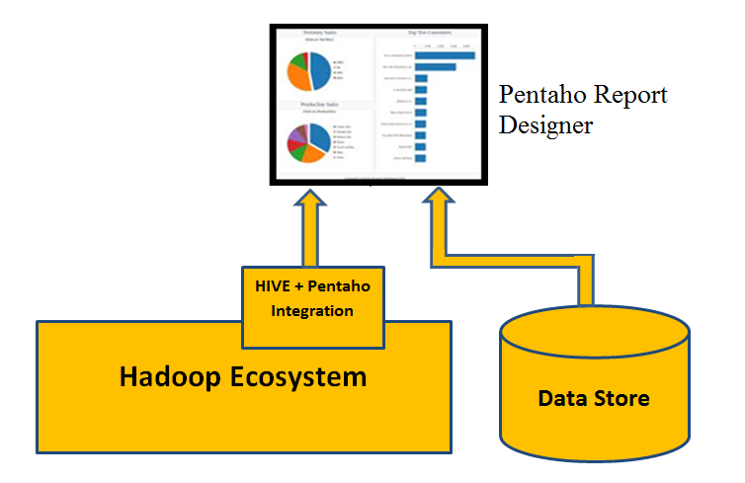
Reporting : Architecture
© Nihilent Technologies 2013

Slide 10
Conclusion
ETL is much better suited for a batch processing system like Hadoop which offers the massive parallel processing(MPP) systems and agility of absorbing data of any type, scalable processing that data, and at an economical cost matched to the value of such raw data.
Gain a competitive edge by extracting insight from any Bigdata source using affordable and scalable analytics and Reporting platform
© Nihilent Technologies 2013

Slide 11
Thank You
© Nihilent Technologies 2013

